Slide 1
Making Sense of the Power BI Ecosystem
David Moss
Azure AI & PowerBI Solution Architect
david@wottabyte.com
Notes:
Downloaded from https://www.sqlsaturday.com/859/Sessions/Details.aspx?sid=89722
By SQL Dusty via https://sqldusty.com/2019/03/11/data-warehouse-design-and-power-bi-at-sql-saturday-tampa-2019/
March 2019

Slide 2
Agenda
What is Power BI?
Overview of the Power BI ecosystem
Power BI Desktop
Excel
Power BI Service (PowerBI.com)
Power BI Data Gateway
Power BI Premium
Power BI Embedded
Power BI Report Server
Power BI Mobile Apps
Power BI Common Data Service

Slide 3
Why are we doing this session?
Power BI has changed a lot in the last year!
There’s a lot of moving parts!
It’s can be confusing!

Slide 4
Goals
Provide overview of the ecosystem
Eliminate confusion
Provide clarity on when to use what pieces

Slide 5
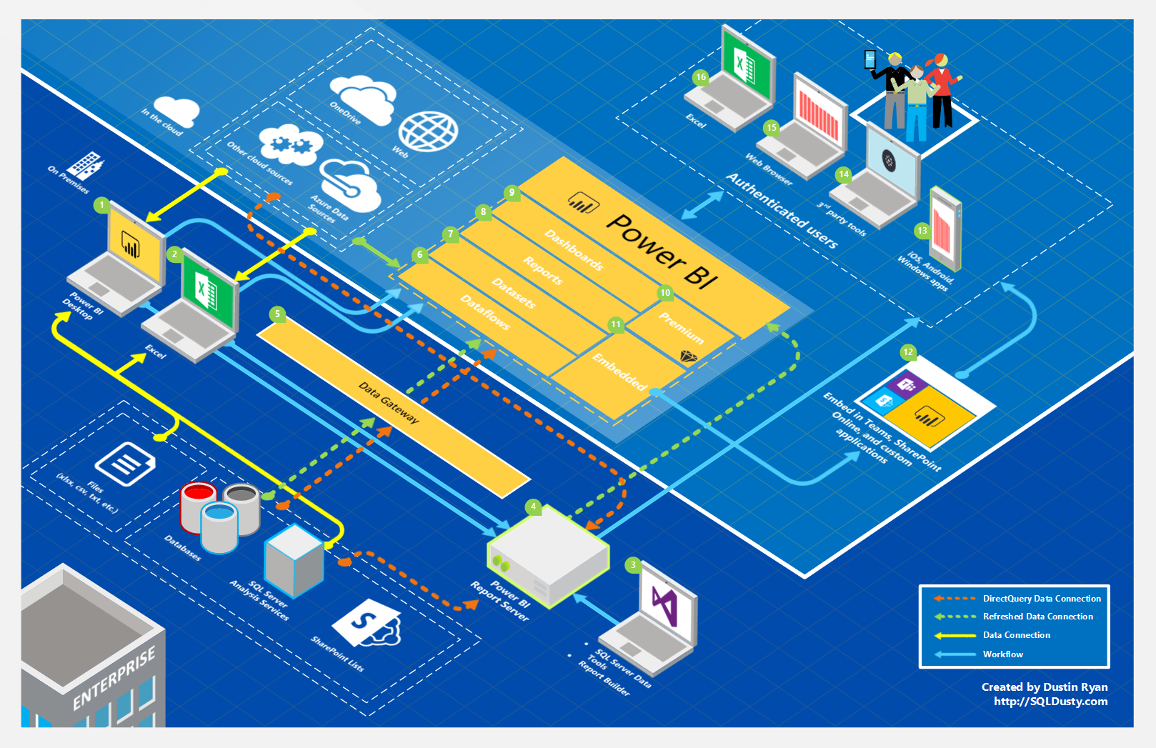

Slide 6
What is Power BI?
Cloud-based analytics & reporting ecosystem
Connects to a wide range of data sources
Supports data modeling, mashup, and data cleansing/transformation
Flexible and interactive visualizations
Distribution to any user on any device
Public distribution
Download this at SQLDusty.com

Slide 7
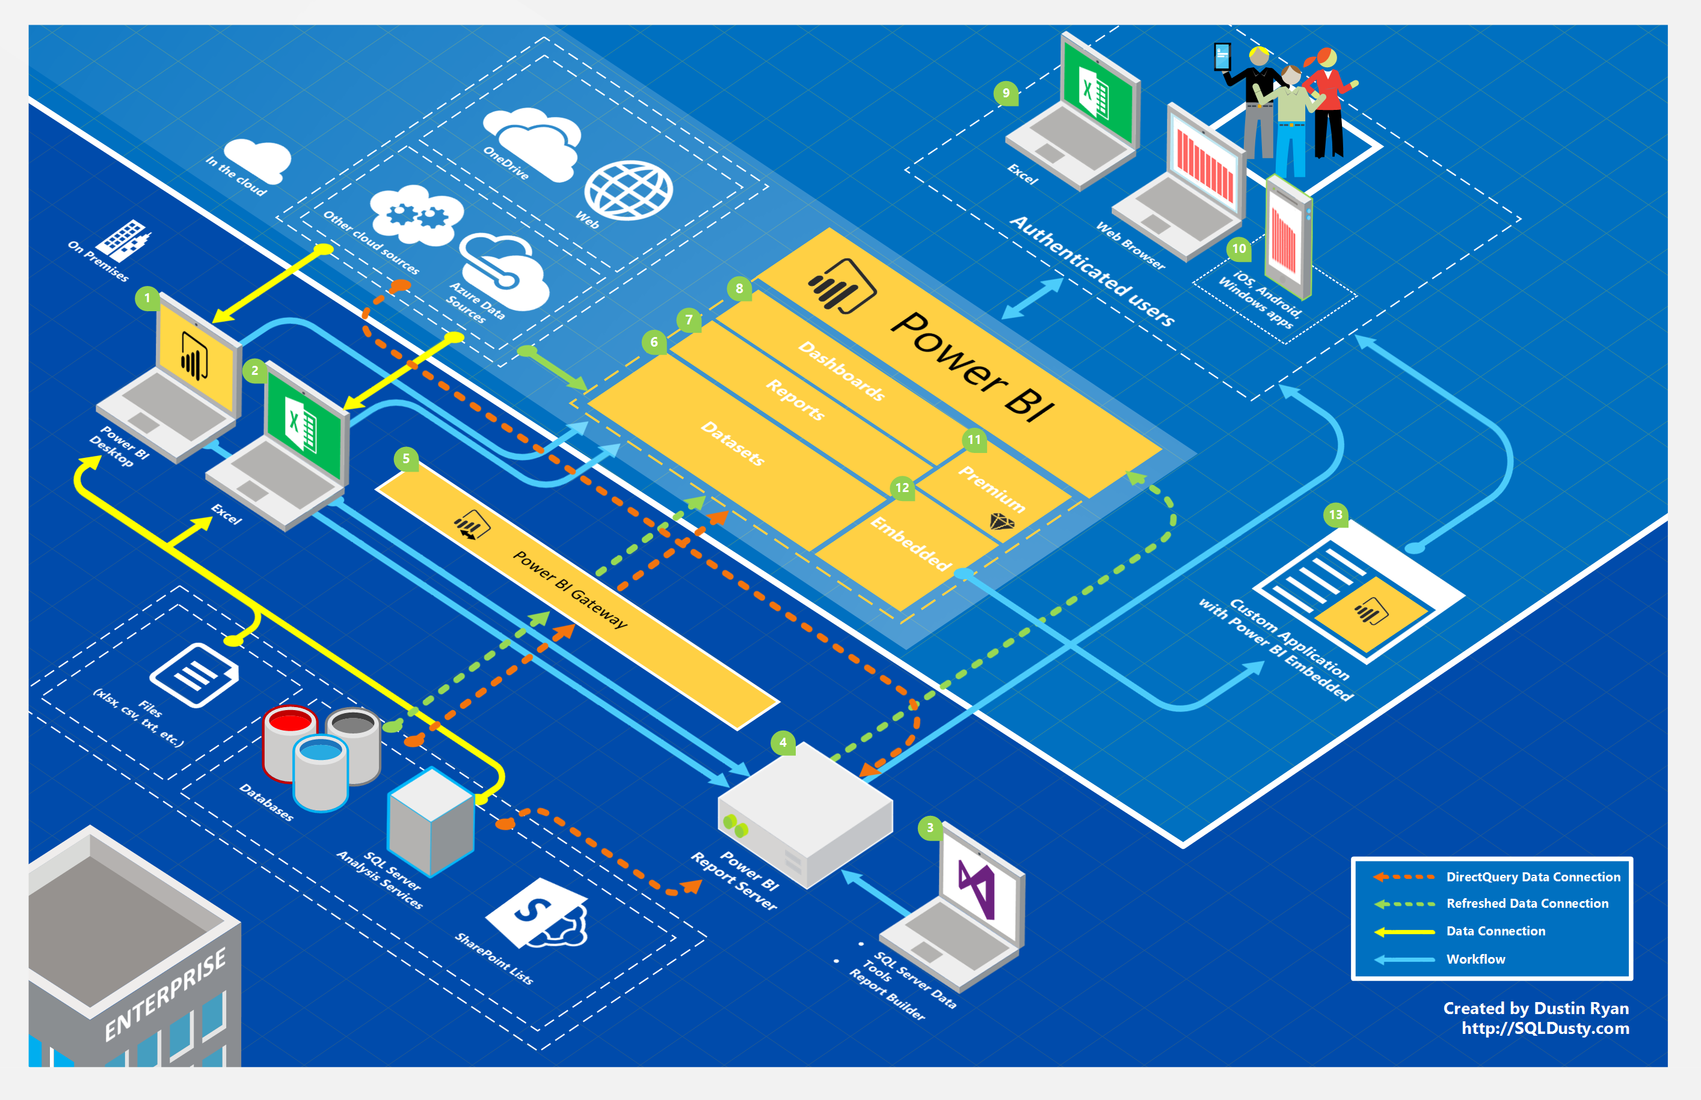
Power BI Desktop
Main authoring and publishing tool for Power BI
Developers and power users would use to create brand new models and reports from scratch
Installed on a developer work station
Costs $0 aka Free

Slide 8
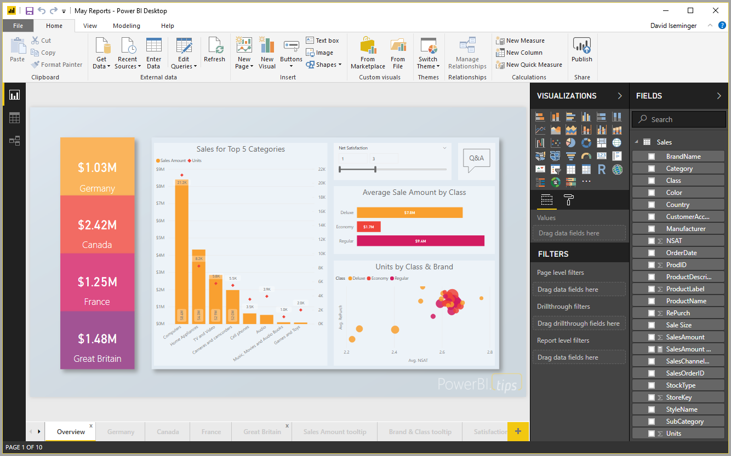
Download at Microsoft Store or https://powerbi.microsoft.com/en-us/desktop/

Slide 9
Excel
World’s most popular BI tool
Can be used to develop data models using Power Pivot, complex data queries using Power Query, and visualizations with Power View
Browse Power BI data models
Used by developers and power users
Installed on local workstation
Costs $0 to use BI plugins, no tacos

Slide 10
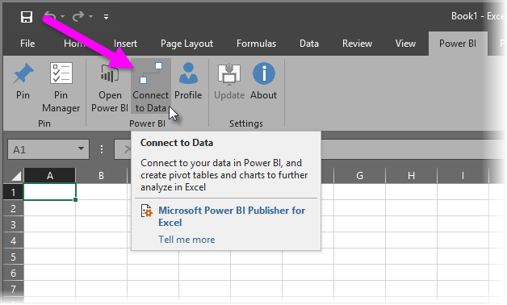
Download Power BI Publisher for Excel
Stopped April 19

Slide 11
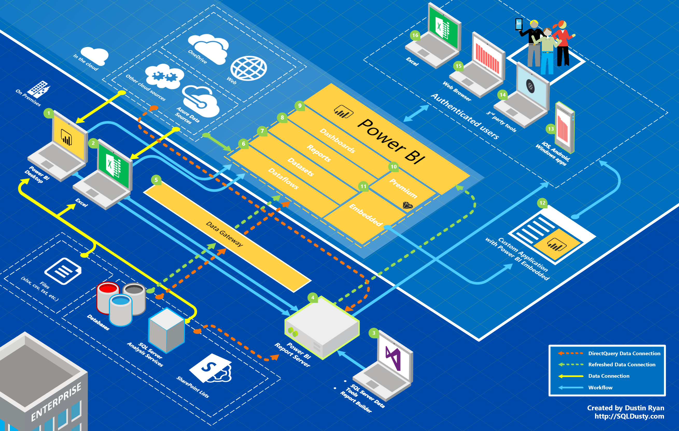
Power BI Service
Online Software as a Service (SaaS) where Power BI data models, reports, dashboards are hosted
Admin, sharing, collaboration happen here
Creation of Dashboards, Reports, Datasets, Dataflows
Most everyone uses it: developers, consumers, power users, admins
Pro license: ~$10/users/month
Premium: More $

Slide 12
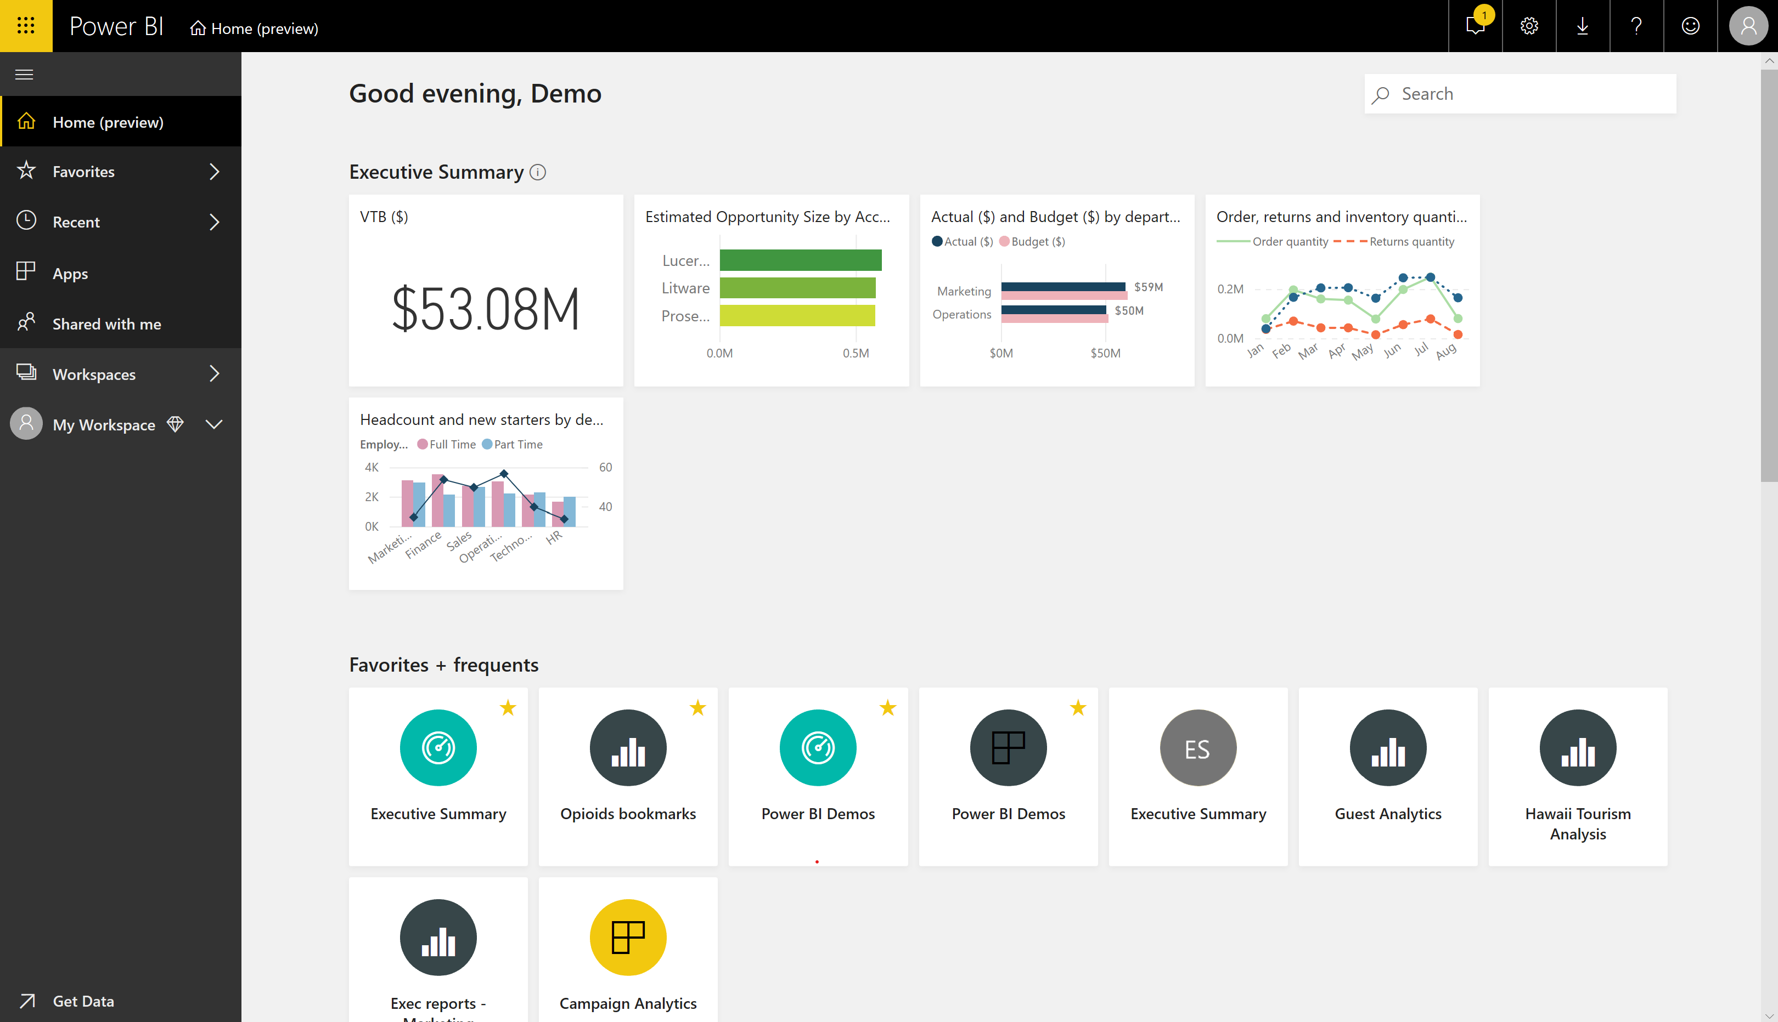

Slide 13
Power BI Data Gateway
Acts as the bridge between the Power BI Service and your on-premise data sources (DirectQuery, Import, Live Query)
Installed/managed by IT/Power BI Admin (Enterprise)
Installed/managed by power user (Personal)
Users access reports that use the gateway
Costs nothing included with Power BI subscription

Slide 14
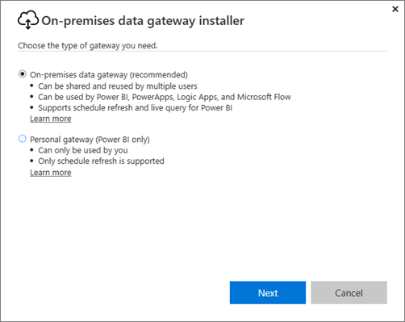
Download the Data Gateway here

Slide 15
Power BI Premium
Dedicated capacity for running the Power BI organization for your team only
Supports sharing across the enterprise
Supports embedding in custom applications, SharePoint Online, Teams
Licensed at a capacity level instead of by user
Managed by Power BI Admin and/or Power BI Capacity Admin
Notes:
Power BI Premium provides resources dedicated to running the Power BI service for your organization or team, giving you more dependable performance and larger data volumes. Premium also enables widespread distribution of content without requiring you to purchase per-user licenses for viewers.
You can take advantage of Power BI Premium by assigning workspaces to a Premium capacity. Premium capacity is a dedicated resource for your organization. For workspaces that are not assigned to a premium capacity, these will be in a shared capacity.

Slide 16
A Dedicated Instance of the Power BI Service
Power BI
Power BI Premium
Power BI Premium
Power BI Premium
Customer 1
Customers 1, 2, 3, … n
Customer 2
Customer 3
Notes:
Power BI Premium is an add-on for the Power BI service.
Power BI Premium is basically your own private server running the Power BI architecture in Azure
To understand why that’s important, it helps to understand the existing architecture for the Power BI.
Currently, Power BI runs on clusters of machines that all of the Power BI customers use.
Because of this, Power BI places restriction on how much capacity and resources that an individual can use so that no single user has a really negative experience.
With Power BI Premium, all the capacity is yours.
Because the capacity of Power BI Premium services belong to you, this allows many of the restrictions and limitations of the Power BI service to be lifted giving you greater control over how resources dedicated to your Power BI service are managed.

Slide 17


Licensing your organization
Power BI
Data Sources
Reports
Dashboards
P
P
P
P
P
P
P
P
P
Premium
Power BI developers
Reports
Dashboards
P
P
P
Power BI consumers
Notes:
Now lets talk about an example:
Say you have a requirement to distribute Power BI reports and dashboards to your entire organization or at least to a large number of members of your organization.
Prior to Power BI Premium, you would need to purchase a Power BI Pro license for the your development team that would be building the Power BI reports and dashboards, and you would also need to purchase Pro licenses for the consumers of the content.
This could make life difficult if you have a large number of users wishing to access the Power BI content. Per user licensing for 30,000 users, for example, would very expensive and difficult to manage.
With Power BI Premium, you now have the flexibility to deploy your Power BI content to your dedicated capacity.
This would allow the members of your organization to access the Power BI content without needing a Pro license.
Your developers would still be licensed for Power BI Pro, as they’re the users that are creating, sharing, and administrating Power BI in your organization, but the consumers of the content would no longer require a Pro license.
Because your Power BI content is deployed to your dedicated capacity via Power BI Premium, this means we can also scale up when we need to by purchasing more capacity.
Another example would be if you had users of a SharePointOnline site accessing an embedded Power BI report.
The users log in to the SharePointOnline site, view the Power BI report,

Slide 18
Workspace 1
Workspace 2
Workspace 3
Shared Capacity
Premium Capacity

Slide 19
Power BI Premium Capacity Breakdown
Capacity Node | Cores | Backend Cores | Front End Cores | Price
P1 | 8 v-cores | 4 cores, 25 GB RAM | 4 cores | $4,995/month
P2 | 16 v-cores | 8 cores, 50 GB RAM | 8 cores | $9,990/month
P3 | 32 v-cores | 16 cores, 100 GB RAM | 16 cores | $19,980/month

Slide 20
Power BI Embedded
Allows developers to embed analytics into any app using the Power BI APIs
Scale up, scale down, pause services
Different than Power BI Premium
Used by developers to embed BI in apps
Consumed by users of the app
Managed in Azure and Power BI portal
Starts at about $1/hour
Notes:
With Power BI Embedded, ISVs and developers have added flexibility in how they embed intelligence in their apps using the Power BI APIs. ISVs and developers can take advantage of minimized development efforts to achieve faster time to market and differentiate themselves by infusing Microsoft’s world-class analytics engine in their app. Equally, developers can spend time focusing on their solution to meet customer demands, instead of developing visual analytics features. Additionally, Power BI Embedded enables you to work within the familiar development environments – Visual Studio and Azure – you already use.

Slide 21

When to use which Power BI SKU?
 | Embedded |  | Premium
 | A SKUs | E SKUs | P SKUs
Embed in custom application
Embed in SPO & Teams
Share Reports through Power BI Service (portal)
Smallest billing unit | Hour | Month | Month
Can pause?

Slide 22
*Power BI Report Server
SQL Server Reporting Services + Power BI Desktop Reports
Superset of the features included with SSRS
Can host paginated reports, KPIs, mobile reports, & Power BI Desktop reports
Update released every 4 months
Installed/managed by IT
Power users can modify Power BI reports
Other reports developed by dev team
Consumed by users
Included with Premium but can also purchase w/ SQL EE + SA
Notes:
Power BI Report Server is an on-premises report server with a web portal in which you display and manage reports and KPIs, along with the tools to create Power BI reports, paginated reports, mobile reports, and KPIs. Your users can access those reports in different ways: viewing them in a web browser or mobile device, or as an email in their in-box.

Slide 23
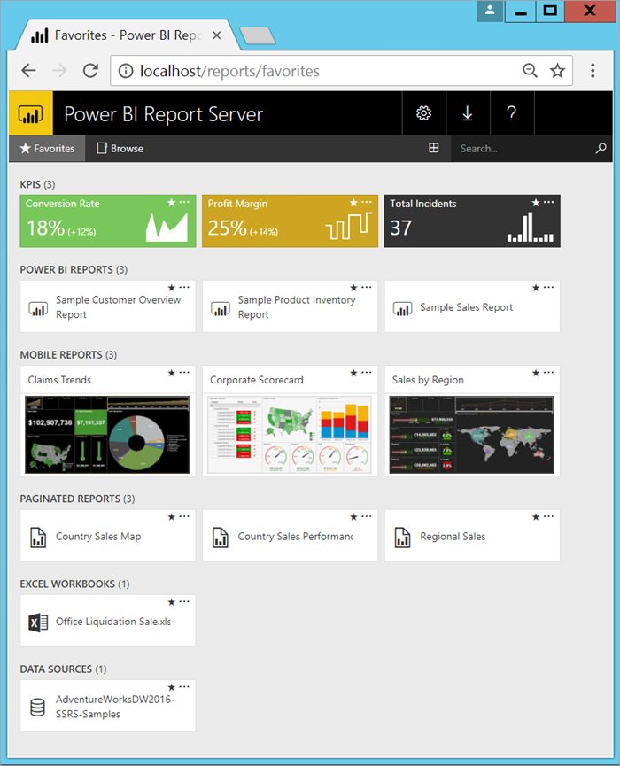
Download Power BI Report Server

Slide 24
Power BI RS vs Power BI Service
Features | Power BI Report Server | Power BI Service
Deployment | On-premises or hosted cloud | Cloud
Source data | Cloud and/or on-premises | Cloud and/or on-premises
License | Power BI Premium or SQL Server EE with SA | Power BI Pro and Power BI Premium
Lifecycle | Modern lifecycle policy | Fully managed service
Release cycle | Once every ~4 months | Once a month
Create Power BI reports in Power BI Desktop | Yes | Yes
Create Power BI reports in the browser | No | Yes
Gateway required | No | Yes for on-premises data sources
Real-time streaming | No | Yes
Dashboards | No | Yes
Distribute group of reports using apps | No | Yes
Connect to services like Salesforce | No | Yes
Q&A | No | Yes
Analyze/Quick insights | No | Yes
Machine Learning/Predictive Analytics integration | No | Yes
Analyze in Excel | No | Yes
Paginated reports | Yes | Yes
Power BI mobile apps integration | Yes | Yes
ARC GIS maps | No | Yes
Dataflows | No | Yes
Email subscriptions for Power BI reports | No | Yes
Email subscriptions for paginated reports | Yes | Yes
Data alerts | No | Yes
Row-level security | Yes | Yes
Full screen mode | No | Yes
Advanced Office 365 collaboration | No | Yes
R & Python visuals | No | Yes
Preview features | No | Yes
Custom visuals | Yes | Yes
Power BI Desktop | Version optimized for Report Server, available for download with Report Server | Version optimized for Power BI Service, available from the Windows Store

Slide 25
Power BI Mobile Apps
Mobile apps on iOS, Android, Windows all no cost to download
Can be managed using Microsoft Intune
Can be used to view reports and dashboards on the Power BI Service as well as reports in Power BI Report Server
Can also be used to collaborate and set up data alerts
Reports/dashboards are automatically available on mobile devices
Costs $0, no tacos
Notes:
Microsoft Intune lets organizations control items like requiring an access pin, controlling how data is handled by the application, and even encrypting application data when the app isn't in use.

Slide 26
Power BI Dataflows
Self service capability to connect and transform siloed data
Allows you to unify disconnected data for modeling
Data is stored in Common Data Model compliant folders in Azure Data Lake Storage Gen2
Create Power BI Datasets based on your Dataflows and Common Data Model
Public Preview on Premium today…
Will be available in Power BI Pro and Premium
Dashboards
Reports
Datasets
Dataflows
*Sign up to get updates
Notes:
Traditionally to solve for this “big data” challenge, you would connect to and ingest all the data from these separate services and apps into a big data store. Transform the ingested data; map and integrate the disparate data elements by developing a common schema
You will then automate this entire process so that the integrated dataset is refreshed every time the underlying data changes.
This process is normally referred to as Data Warehousing.
Power BI introduces Dataflows to help organizations unify data from disparate sources and prepare it for modeling.
You can then easily create dataflows, using familiar, self-service tools.
Dataflows are used to ingest, transform, integrate, and enrich big data by defining data source connections, ETL logic, refresh schedules, and more.
Data is stored as entities in Common Data Model compliant folders in Azure Data Lake Storage Gen2.
Dataflows are created and managed in app workspaces by using the Power BI service.
You can use dataflows to ingest data from a large and growing set of supported on-premises and cloud- based data sources including Dynamics 365, Salesforce, Azure SQL Database, Excel, SharePoint, and more.
You can then map data to known Common Data Model entities, modify and extend existing entities, and create custom entities.
Advanced users can create fully customized dataflows, using a self-service, low-code/no-code, built-in Power Query authoring experience, similar to the Power Query experience that millions of Power BI Desktop and Excel users already know.
Once you’ve created a dataflow, you can use Power BI Desktop and the Power BI service to create datasets, reports, dashboards, and apps that leverage the power of the Common Data Model to drive deep insights into your business activities.

Slide 27
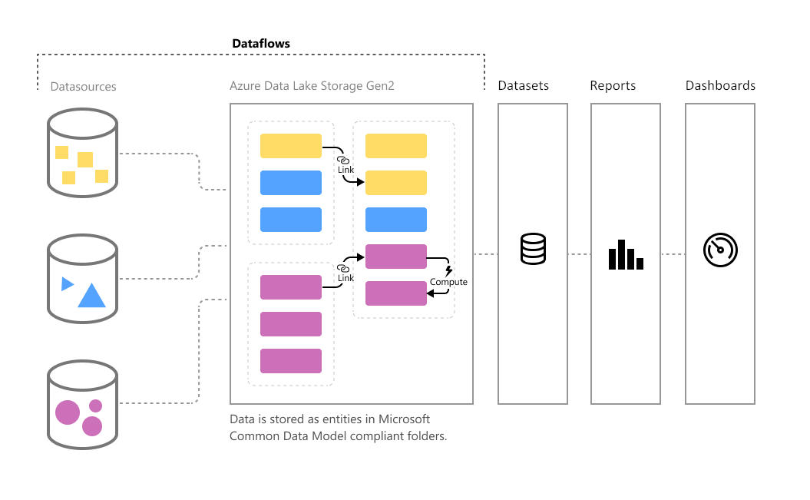
View documentation on self-service data prep with Power BI Dataflows

Slide 28
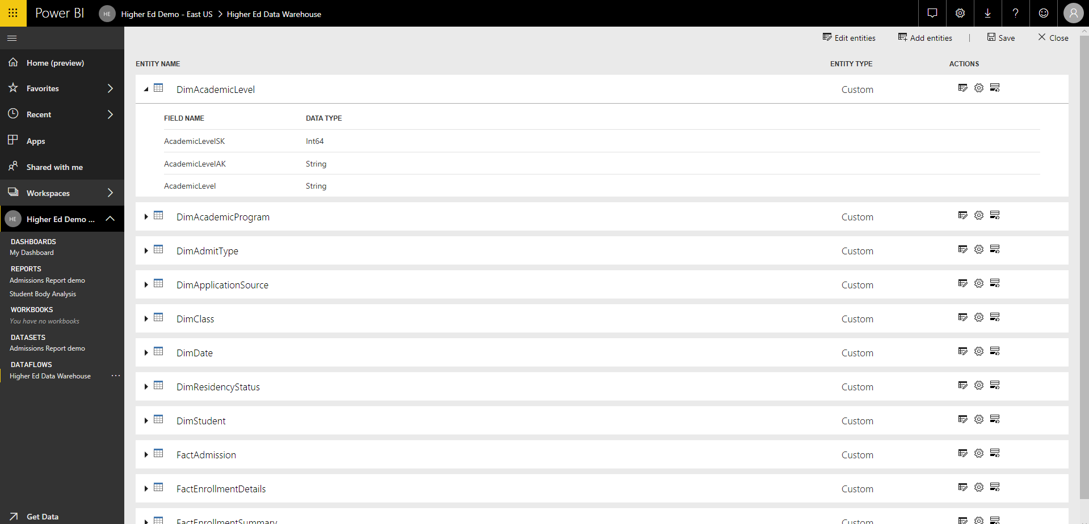

Slide 29
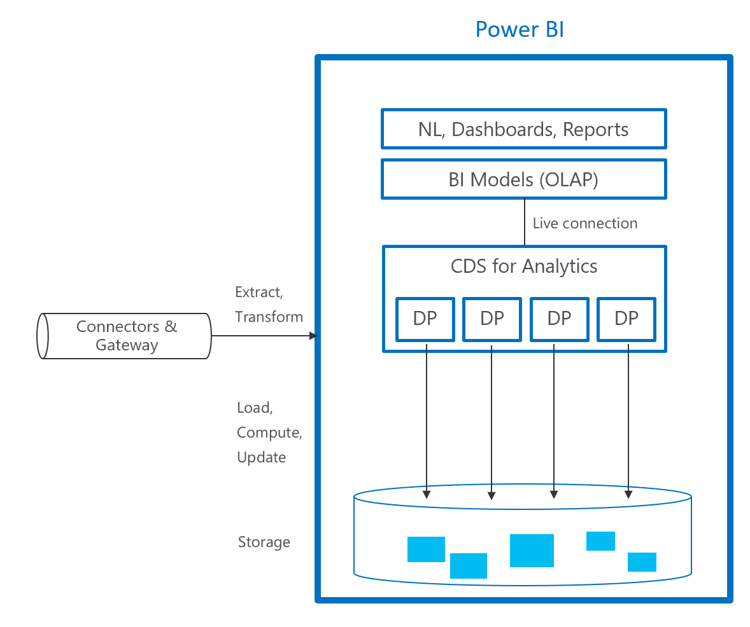
Power BI Common Data Service
Helps solve big data challenge
Self service capability to connect and transform siloed data
Standardized, extensible business app schema to support and expediate data integration and analytics
Will be available in Power BI Pro & Premium
Not available yet ☹
*Sign up to get updates on Power BI CDS
Notes:
Traditionally to solve for this “big data” challenge, you would connect to and ingest all the data from these separate services and apps into a big data store. Transform the ingested data; map and integrate the disparate data elements by developing a common schema
You will then automate this entire process so that the integrated dataset is refreshed every time the underlying data changes.
This process is normally referred to as Data Warehousing.
CDS for Analytics uses a known schema and data model instance from which reports, dashboards, natural language queries, and other quick-insight analytics can automatically be created.
Data brought into the CDS-Analytics format is held in an organization’s tenant-based datapool instance in Azure, using the specified schema and data model, to facilitate the creation of ready-made analytics in Power BI.
Organizations can define the types of reports and analytics they want their CDS-A schema and model to create.
Some services already use the CDS-A schema and model, such as Dynamics 365 , while other services or sources can get data into the CDS-A schema using Microsoft’s extensive existing collection of data connectors.

Slide 30
Licensing your organization
Power BI
Data Sources
Reports
Dashboards
P
P
P
P
P
P
P
P
P
Premium
Power BI developers
Reports
Dashboards
P
P
P
Power BI consumers
Notes:
Now lets talk about an example:
Say you have a requirement to distribute Power BI reports and dashboards to your entire organization or at least to a large number of members of your organization.
Prior to Power BI Premium, you would need to purchase a Power BI Pro license for the your development team that would be building the Power BI reports and dashboards, and you would also need to purchase Pro licenses for the consumers of the content.
This could make life difficult if you have a large number of users wishing to access the Power BI content. Per user licensing for 30,000 users, for example, would very expensive and difficult to manage.
With Power BI Premium, you now have the flexibility to deploy your Power BI content to your dedicated capacity.
This would allow the members of your organization to access the Power BI content without needing a Pro license.
Your developers would still be licensed for Power BI Pro, as they’re the users that are creating, sharing, and administrating Power BI in your organization, but the consumers of the content would no longer require a Pro license.
Because your Power BI content is deployed to your dedicated capacity via Power BI Premium, this means we can also scale up when we need to by purchasing more capacity.
Another example would be if you had users of a SharePointOnline site accessing an embedded Power BI report.
The users log in to the SharePointOnline site, view the Power BI report,

Slide 32
Thanks to sqldusty.com
https://sqldusty.com/2018/06/09/making-sense-of-the-power-bi-ecosystem-presentation-materials/

